Slide 1
SmartGate with Microsoft Dynamic CRM 365 for Face Recognization

Slide 2

The Face recognition powered Dynamics CRM suite allows you to track returning visitors and
recognize customers.
It simply matches the photos that are already in the system with client’s face captured in real time.
Face detection can also identify attributes, including face landmarks (nose, eyes, etc.), gender, age, and other machine-predicted facial features

Slide 3
How it works
The process can be divided into 2 flows
1 Creating repository
2 Face recognition

Slide 4
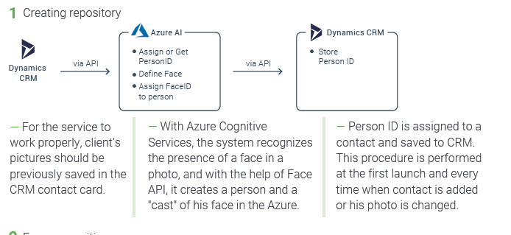

Slide 5
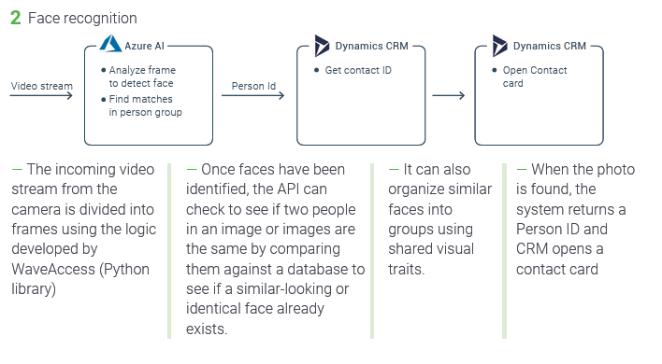

Slide 6
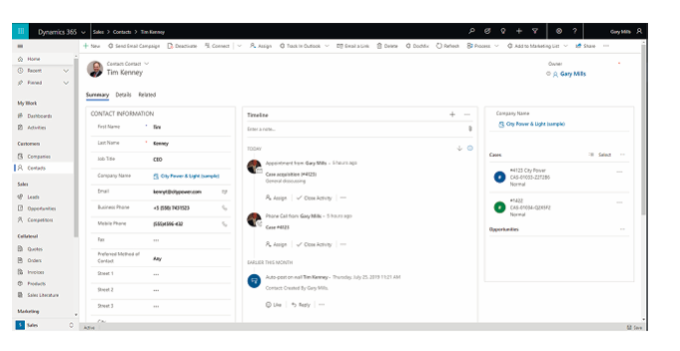

Slide 7
How to use our solution
Reception
Security Control

Slide 8
Thank You

